Slide 1


Session 5: SAM BAM Thank you mam!

Slide 2
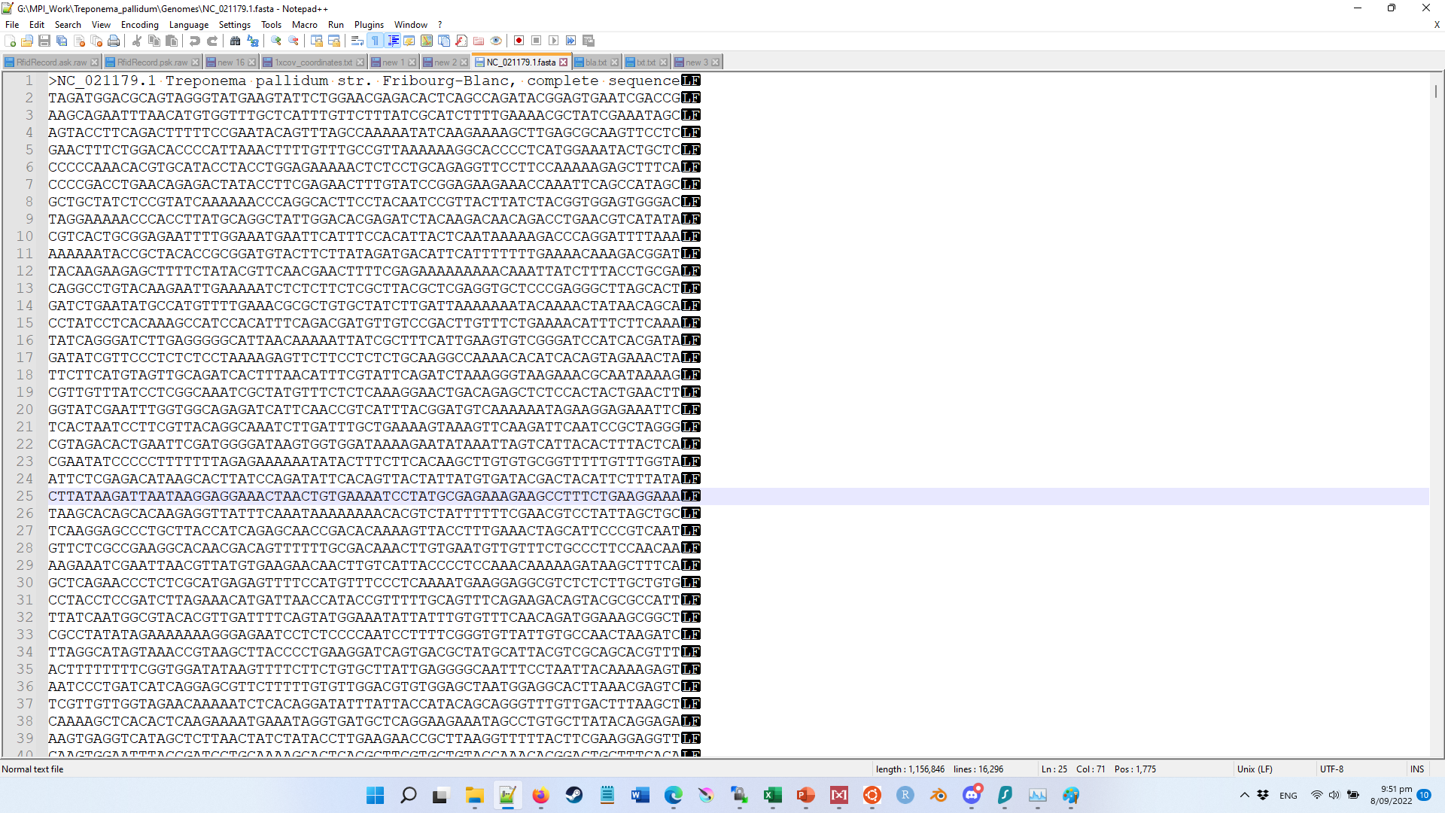
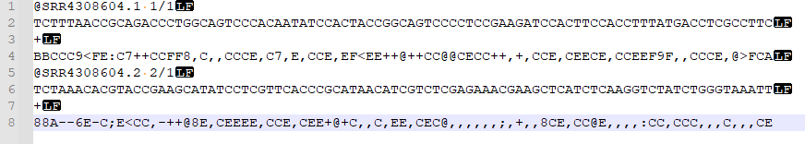

?
?

Slide 3
>Reference_”genome”
ATCGATCGATTATCGATCTTTAACCGCAGACCCTGGCAGTCCCACAATATCCACTACCGGCAGTCCCCTCCGAAGATCCACTTCCACCTTTATGACCTC

Slide 4
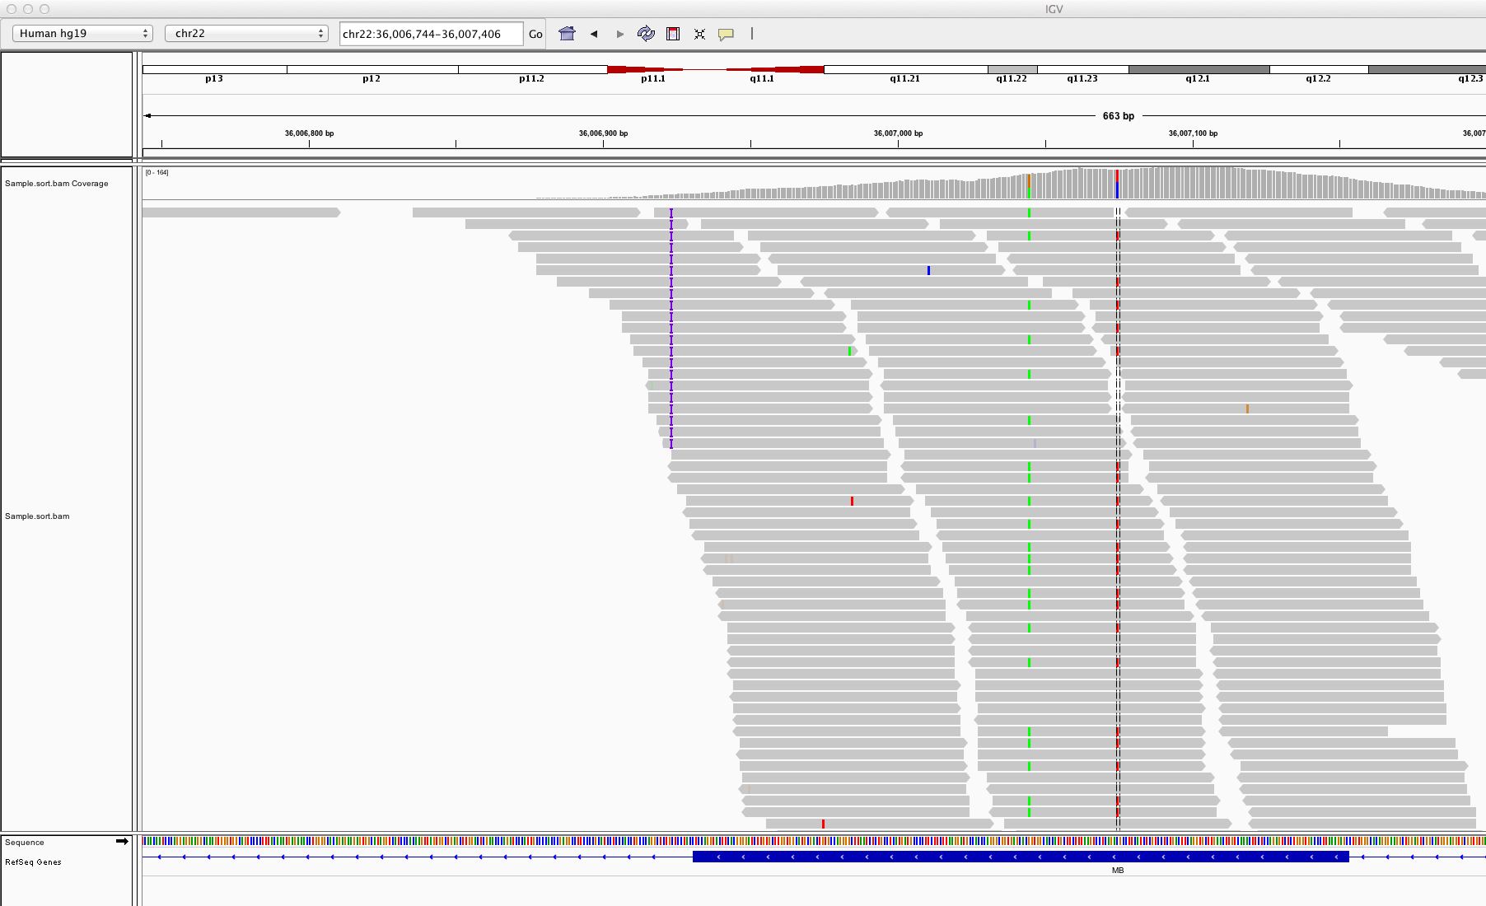
Ref name (filename)
Sequence >header
Coordinates
Seq:start-end
IGV
Integrated
Genome
Viewer
Visual Reference Coordinates
Visualization of “depth” or also
sometimes referred to as X coverage. Not to be confused with % coverage
FastQ read “stack”.
Visual representation of mapping
General Feature Format(has to be added manually)
Sequence track
(is there by default)
Notes:
In IGV, load a reference file with a reference file index. The reference file is a FASTA genome file, the index can be created with samtools faidx by just writing samtools faidx reference_file.fasta Then you load a sorted bam file, sorting helps manage memory consumption as it doesn’t have to read the whole file into memory all the time, only the area’s that you are focussing on samtools sort myfile.bam -o myfile_sorted.bam Lastly, you can add a corresponding gff3 file to your reference genome that has “features” to make it clear what types of genes are encoded in this area

Slide 5
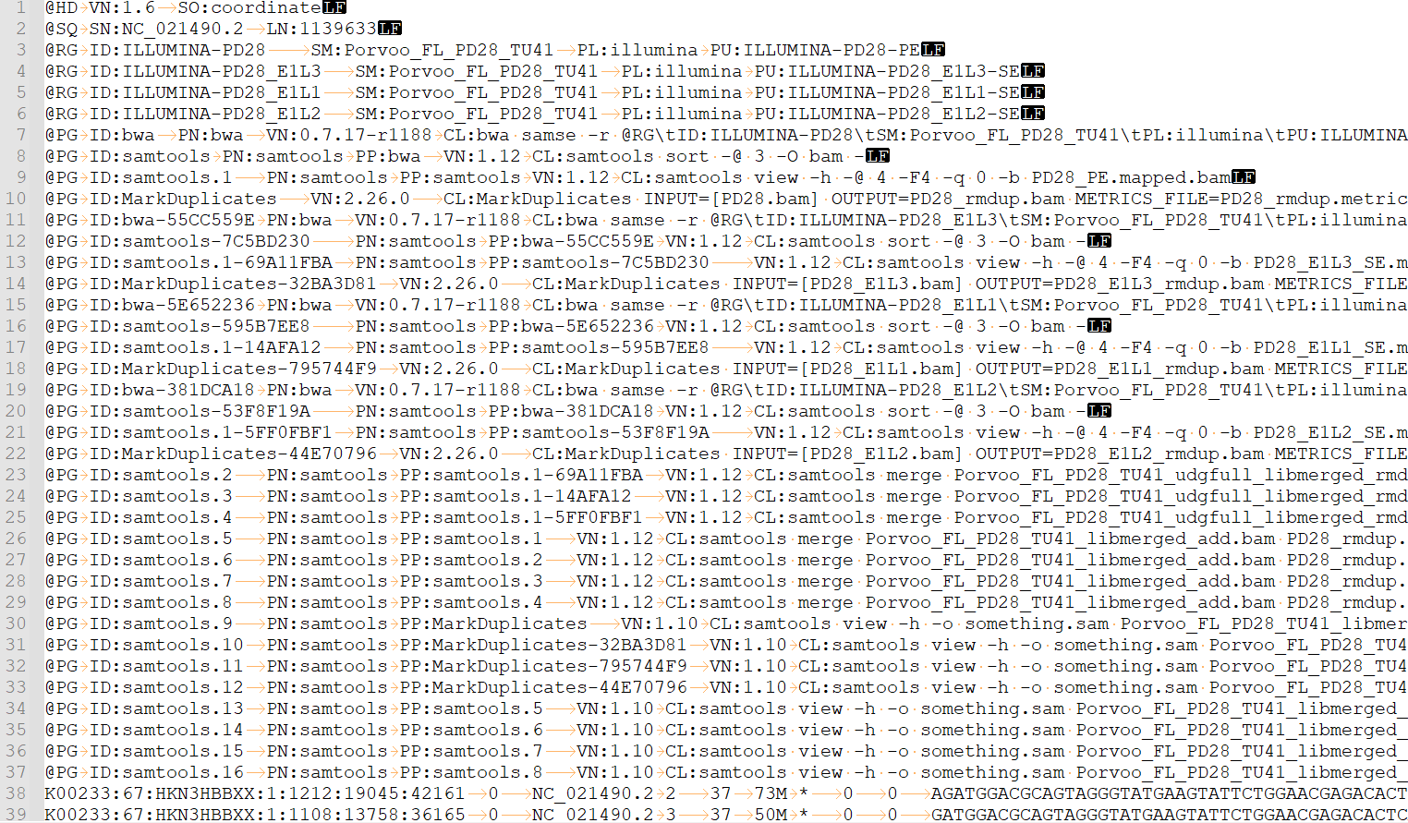
SAM / BAM
Meta data, software track
Reads

Slide 6
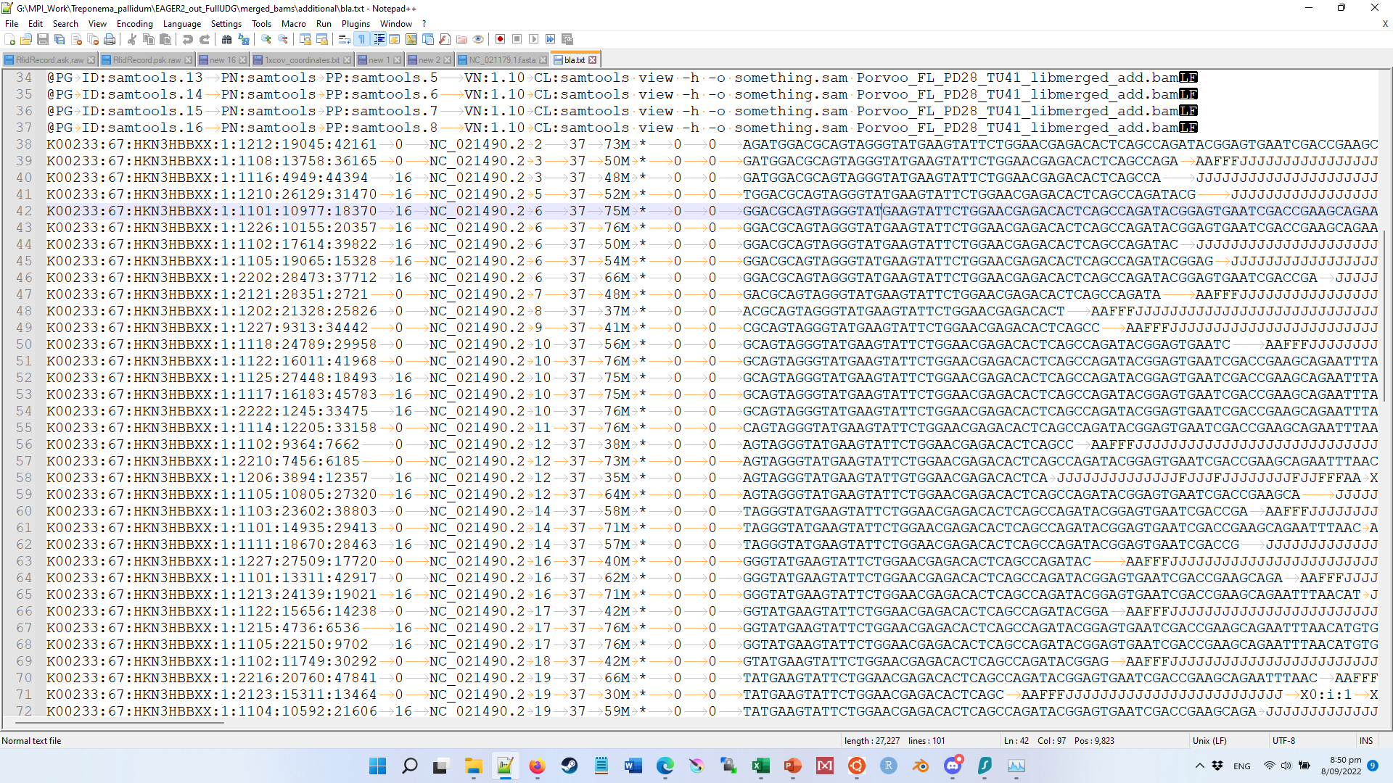
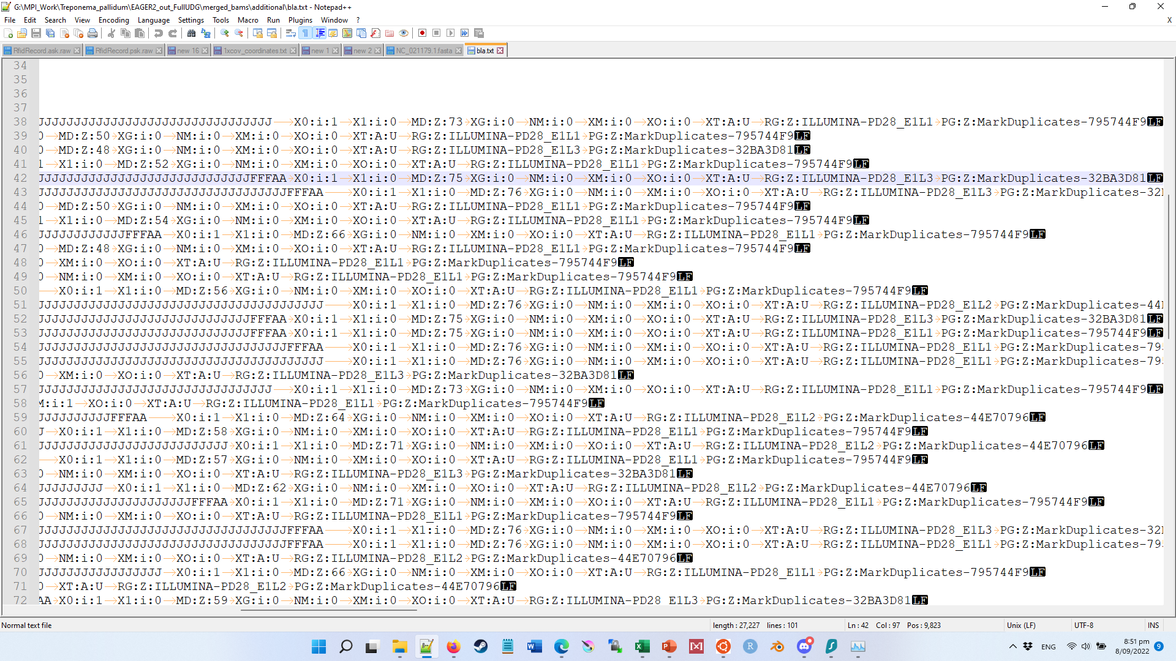
SAM / BAM
Sequence/Binary Alignment Map
Read_name
Ref header
Sequence
PHRED
FLAGS
MapQ
Meta_crap

Slide 7
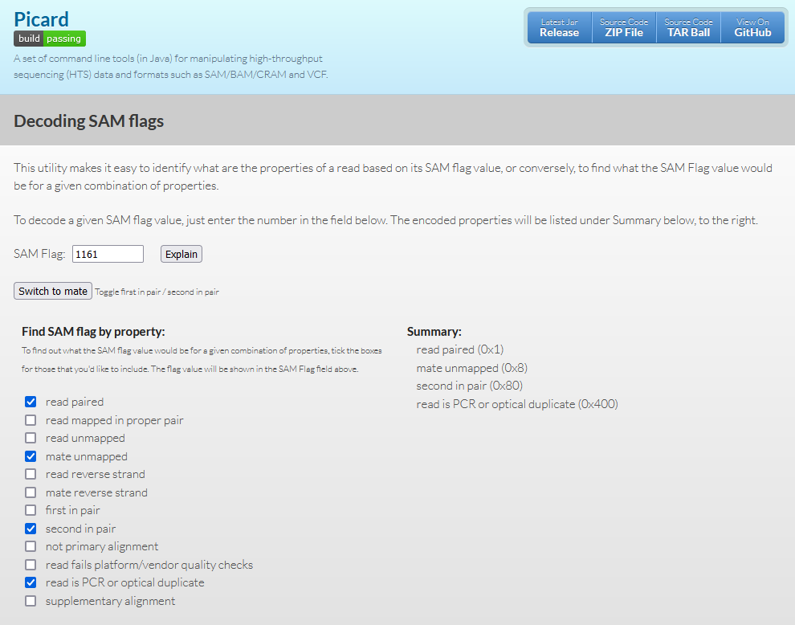
SAM Flags
https://broadinstitute.github.io/picard/explain-flags.html

Slide 8
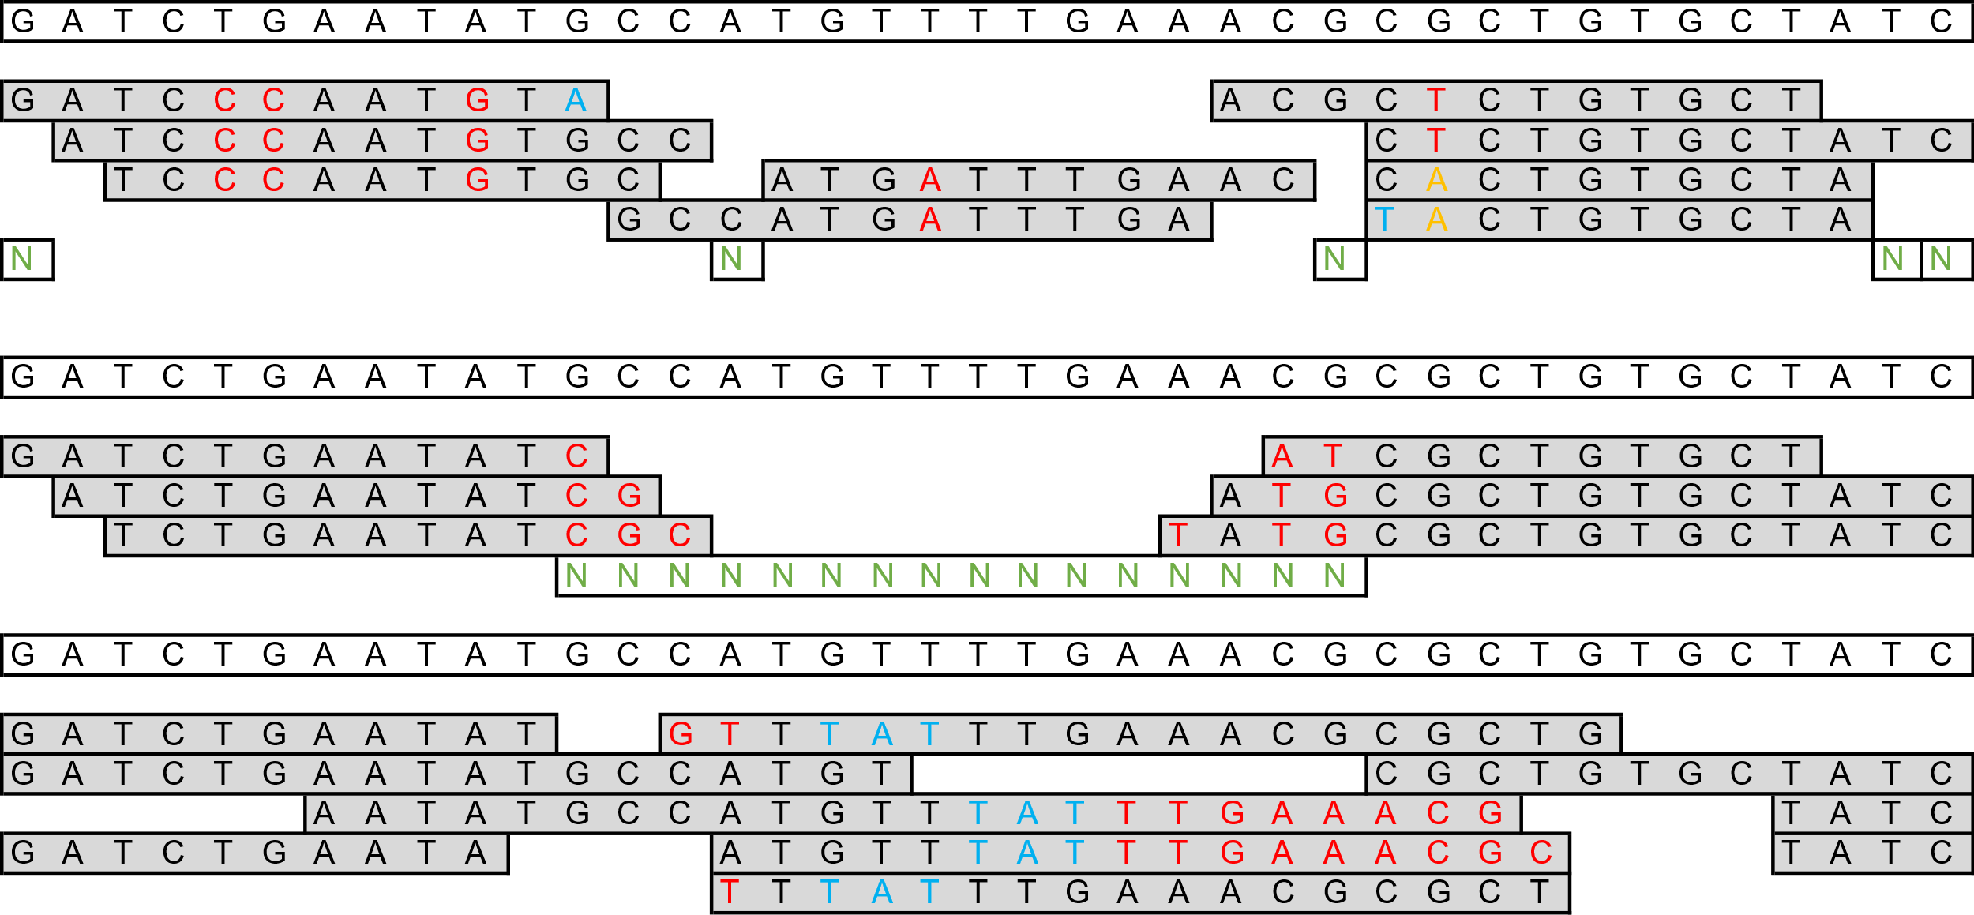
Types of SNPs
Single Nucleotide
Polymorphism

Slide 11
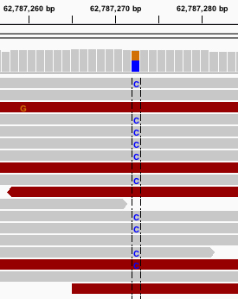
SNP
Notes:
In IGV, load a reference file with a reference file index. The reference file is a FASTA genome file, the index can be created with samtools faidx by just writing samtools faidx reference_file.fasta Then you load a sorted bam file, sorting helps manage memory consumption as it doesn’t have to read the whole file into memory all the time, only the area’s that you are focussing on samtools sort myfile.bam -o myfile_sorted.bam Lastly, you can add a corresponding gff3 file to your reference genome that has “features” to make it clear what types of genes are encoded in this area

Slide 12
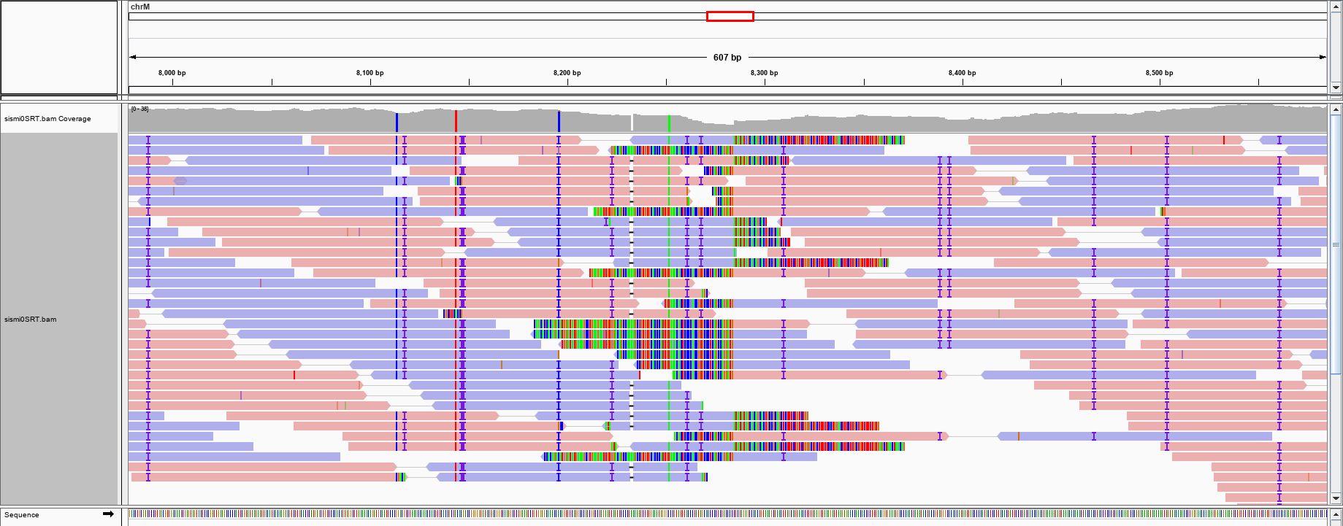
Insertion in the sample compared to the reference
Notes:
In IGV, load a reference file with a reference file index. The reference file is a FASTA genome file, the index can be created with samtools faidx by just writing samtools faidx reference_file.fasta Then you load a sorted bam file, sorting helps manage memory consumption as it doesn’t have to read the whole file into memory all the time, only the area’s that you are focussing on samtools sort myfile.bam -o myfile_sorted.bam Lastly, you can add a corresponding gff3 file to your reference genome that has “features” to make it clear what types of genes are encoded in this area

Slide 13
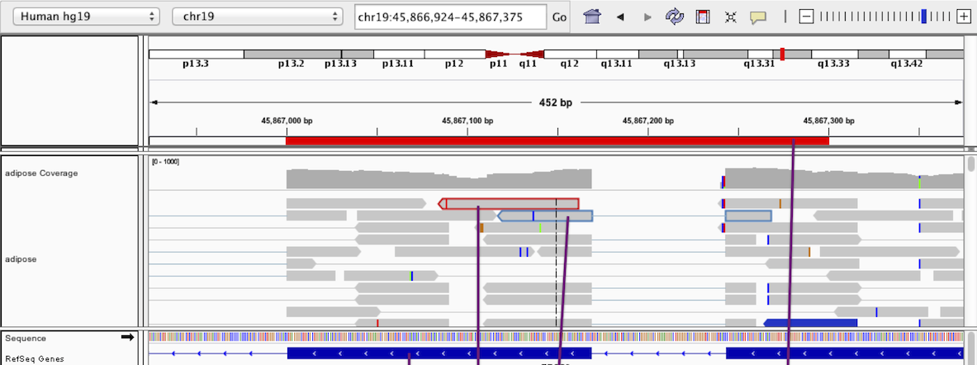
Deletion in the sample compared to the reference
Notes:
In IGV, load a reference file with a reference file index. The reference file is a FASTA genome file, the index can be created with samtools faidx by just writing samtools faidx reference_file.fasta Then you load a sorted bam file, sorting helps manage memory consumption as it doesn’t have to read the whole file into memory all the time, only the area’s that you are focussing on samtools sort myfile.bam -o myfile_sorted.bam Lastly, you can add a corresponding gff3 file to your reference genome that has “features” to make it clear what types of genes are encoded in this area

Slide 14



Slide 15
SAM / BAM
Read_name
Ref header
Sequence
PHRED
FLAGS
MapQ
Meta_crap

Slide 16

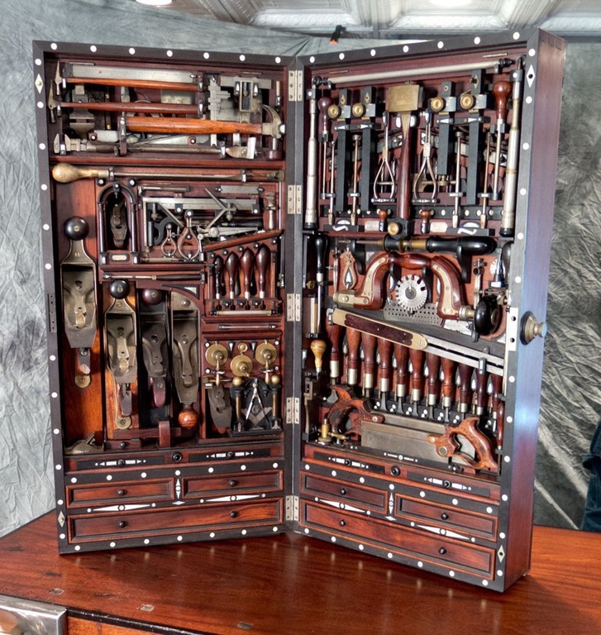



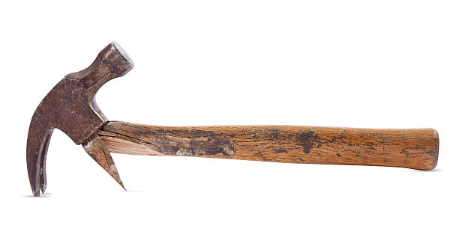

Software = tools…
Old reliable, easy to use
Good for small jobs
Fancy, complicated, takes lot of practice
For small precision work (specialists)
Power tools, do big jobs easy, automation, less control, less precision
Tools:
Freebayes
Samtools mpileup
Bbmap callvariants2
BCFTools / VCFTools
GATK Haplotypecaller
GATK UnifiedGenotyper (UG) (Deprecated)
Etc…
Old, obsolete, abandoned Not updated in a while,
missing dependencies
Straight up broken, sometimes fixable, Mostly not worth the effort
Pet projects, often hyped up in paper
No real practical use, often doesn’t even
do the job it advertises it does.
5% more efficient than all other tools*
*only tested on one outlier dataset with peculiar characteristics

Slide 17
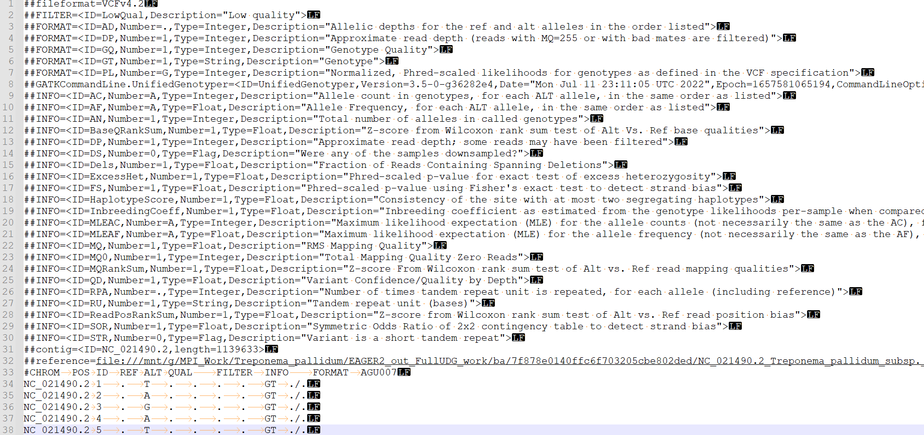
VCF
Variant Call Format
Meta data,
software track
Header
Alleles

Slide 18
VCF
Variant Call Format
Reference
Genotype
Meta data crap
#CHROM | POS | ID | REF | ALT | QUAL | FILTER | INFO | FORMAT | AGU007
NC_021490.2 | 1 | . | T | . | . | . | . | GT | ./.
NC_021490.2 | 2 | . | A | . | . | . | . | GT | ./.
NC_021490.2 | 3 | . | G | . | . | . | . | GT | ./.
NC_021490.2 | 4 | . | A | . | . | . | . | GT | ./.
NC_021490.2 | 5 | . | T | . | . | . | . | GT | ./.
NC_021490.2 | 6 | . | G | . | . | . | . | GT | ./.
NC_021490.2 | 7 | . | G | . | 31.23 | . | AN=2;DP=1;MQ=37.00;MQ0=0 | GT:DP | 0/0:1
NC_021490.2 | 8 | . | A | . | 31.23 | . | AN=2;DP=1;MQ=37.00;MQ0=0 | GT:DP | 0/0:1
NC_021490.2 | 9 | . | C | . | 34.23 | . | AN=2;DP=2;MQ=37.00;MQ0=0 | GT:DP | 0/0:2
NC_021490.2 | 10 | . | G | . | 34.23 | . | AN=2;DP=2;MQ=37.00;MQ0=0 | GT:DP | 0/0:2
NC_021490.2 | 1077 | . | G | A | 13.72 | LowQual | AC=2;AF=1.00;AN=2;DP=1;Dels=0.00;ExcessHet=3.0103;FS=0.000;HaplotypeScore=0.0000;MLEAC=2;MLEAF=1.00;MQ=37.00;MQ0=0;QD=13.72;SOR=1.609 | GT:AD:DP:GQ:PL | 1/1:0,1:1:3:40,3,0
Quality

Slide 19
VCF
Variant Call Format
#CHROM | POS | ID | REF | ALT | QUAL | FILTER | INFO | FORMAT | AGU007
NC_021490.2 | 14 | . | T | . | 40.23 | . | AN=2;DP=4;MQ=37.00;MQ0=0 | GT:DP | 0/0:4
AN | Total number of alleles in called genotypes
DP | Combined depth across samples, e.g. DP=154
MQ | RMS mapping quality, e.g. MQ=52
MQ0 | Number of MAPQ == 0 reads covering this record
GT | Genotype
DP | Read depth
0/0 : the sample is homozygous reference
0/1 : the sample is heterozygous, carrying 1 copy of each of the REF and ALT alleles
1/1 : the sample is homozygous alternate
INFO
FORMAT
Values

Slide 20
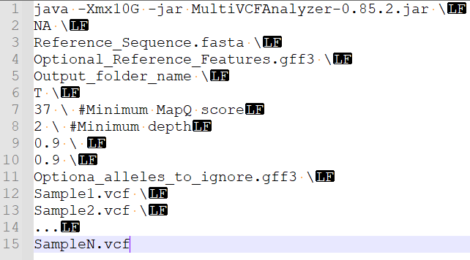
MultiVCFAnalyzer But all roads lead to Rome, this is just one way to merge VCF files into one fasta file.

Slide 21
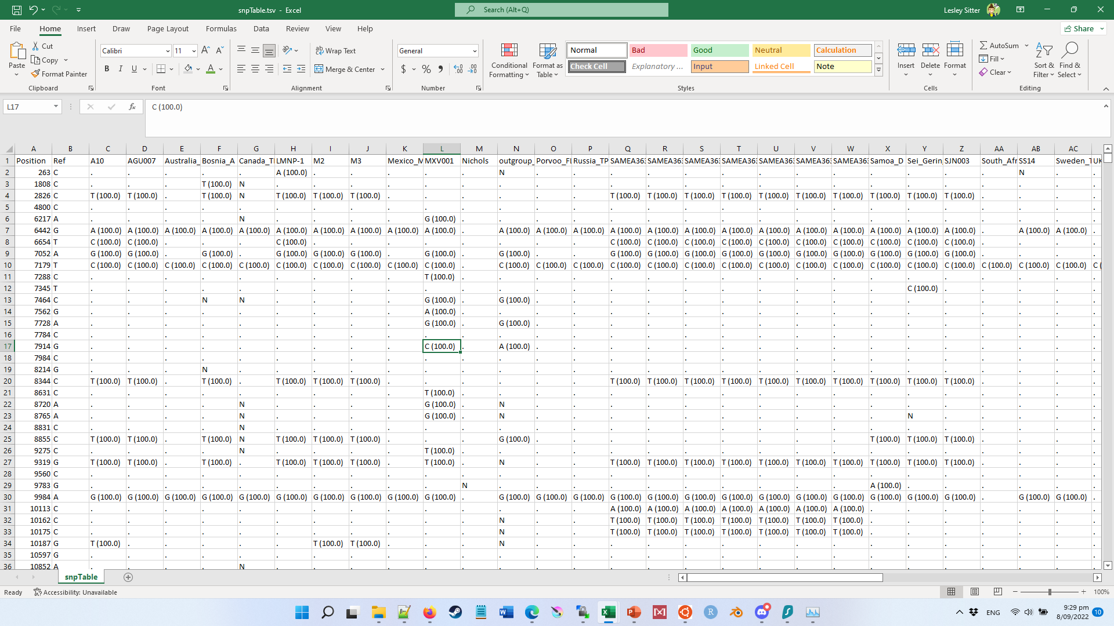
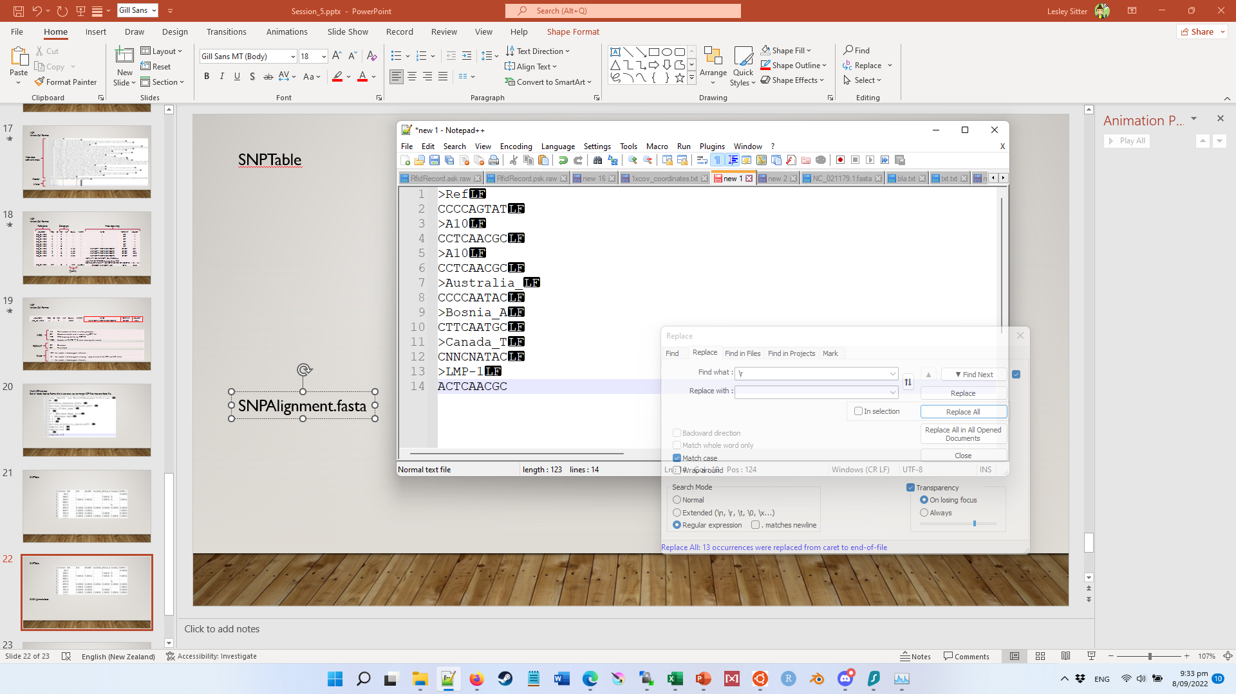
SNPTable
SNPAlignment.fasta
FullAlignment.fasta
Instead of only alleles with >1 SNP, it has ALL sites, essentially reproducing the reference for each sample.

Slide 22
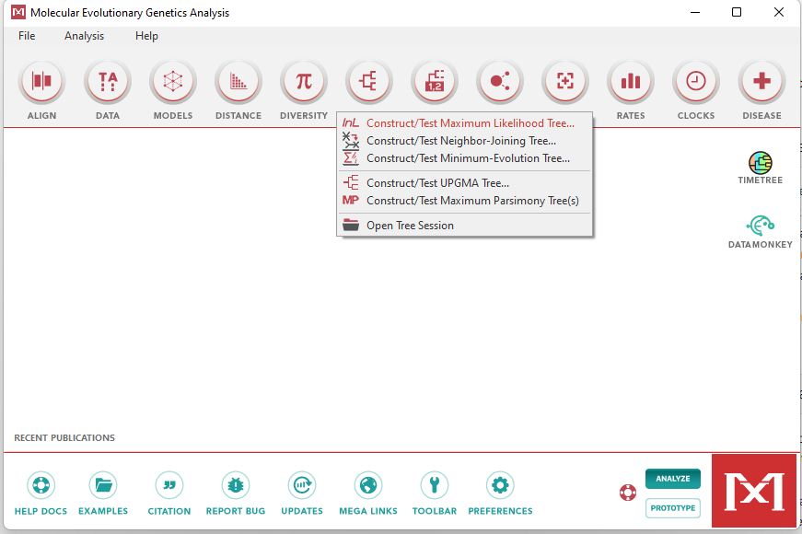
Tree building starter
Download MEGA
Molecular
Evolutionary
Genetics
Analysis
https://megasoftware.net/
Load the SNPalignment.fasta file

Slide 23
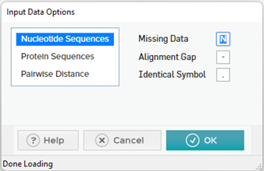
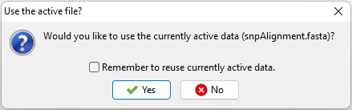
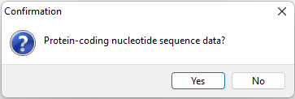
Tree building starter
Download MEGA
Molecular
Evolutionary
Genetics
Analysis
https://megasoftware.net/
Load the SNPalignment.fasta file

Slide 24
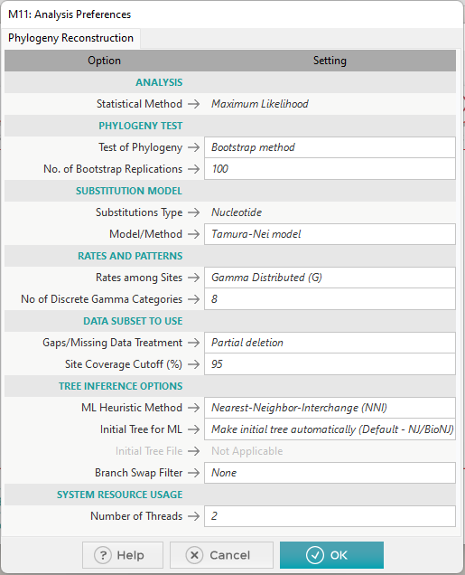
ML - tree
Maximum
Likelihood
Bootstrap is essentially subsampling x times
Model/Method are “substitution” models,
they account for the frequency of substation observed
in nature… these don’t do that much tbh
Partial deletion / full deletion / all sites
These values will determine whether or not an allele is
included based on the number of samples that have
missing data for that allele.
Keep in mind that if you have
10 samples, there is no difference between 92-95-97, since
all values equal 1 sample in 10.

Slide 25



